Slide 1



×
Sales Performance Analytics
Kimia Farma - Big Data Analytics 📊
Presented by
Egi Fermana Putra

Slide 2




Hello! 👋🏻
Egi Fermana Putra
Data enthusiast with a strong foundation in statistical data analyses with a degree from Universitas Medika Suherman. Dedicated my academic journey to unraveling insight, particularly in academic research, thesis papers, and community projects to inform evidence-based decision-making. Proficient in statistical methods such as chi-square, t-test, and linear regression, etc. Tools such as Python and its libraries for data analysis, R Studio, SQL, SPSS Statistics, Looker Studio, and Microsoft Excel.
egifermn@gmail.com
Egi Fermana Putra
egifermana

Slide 3
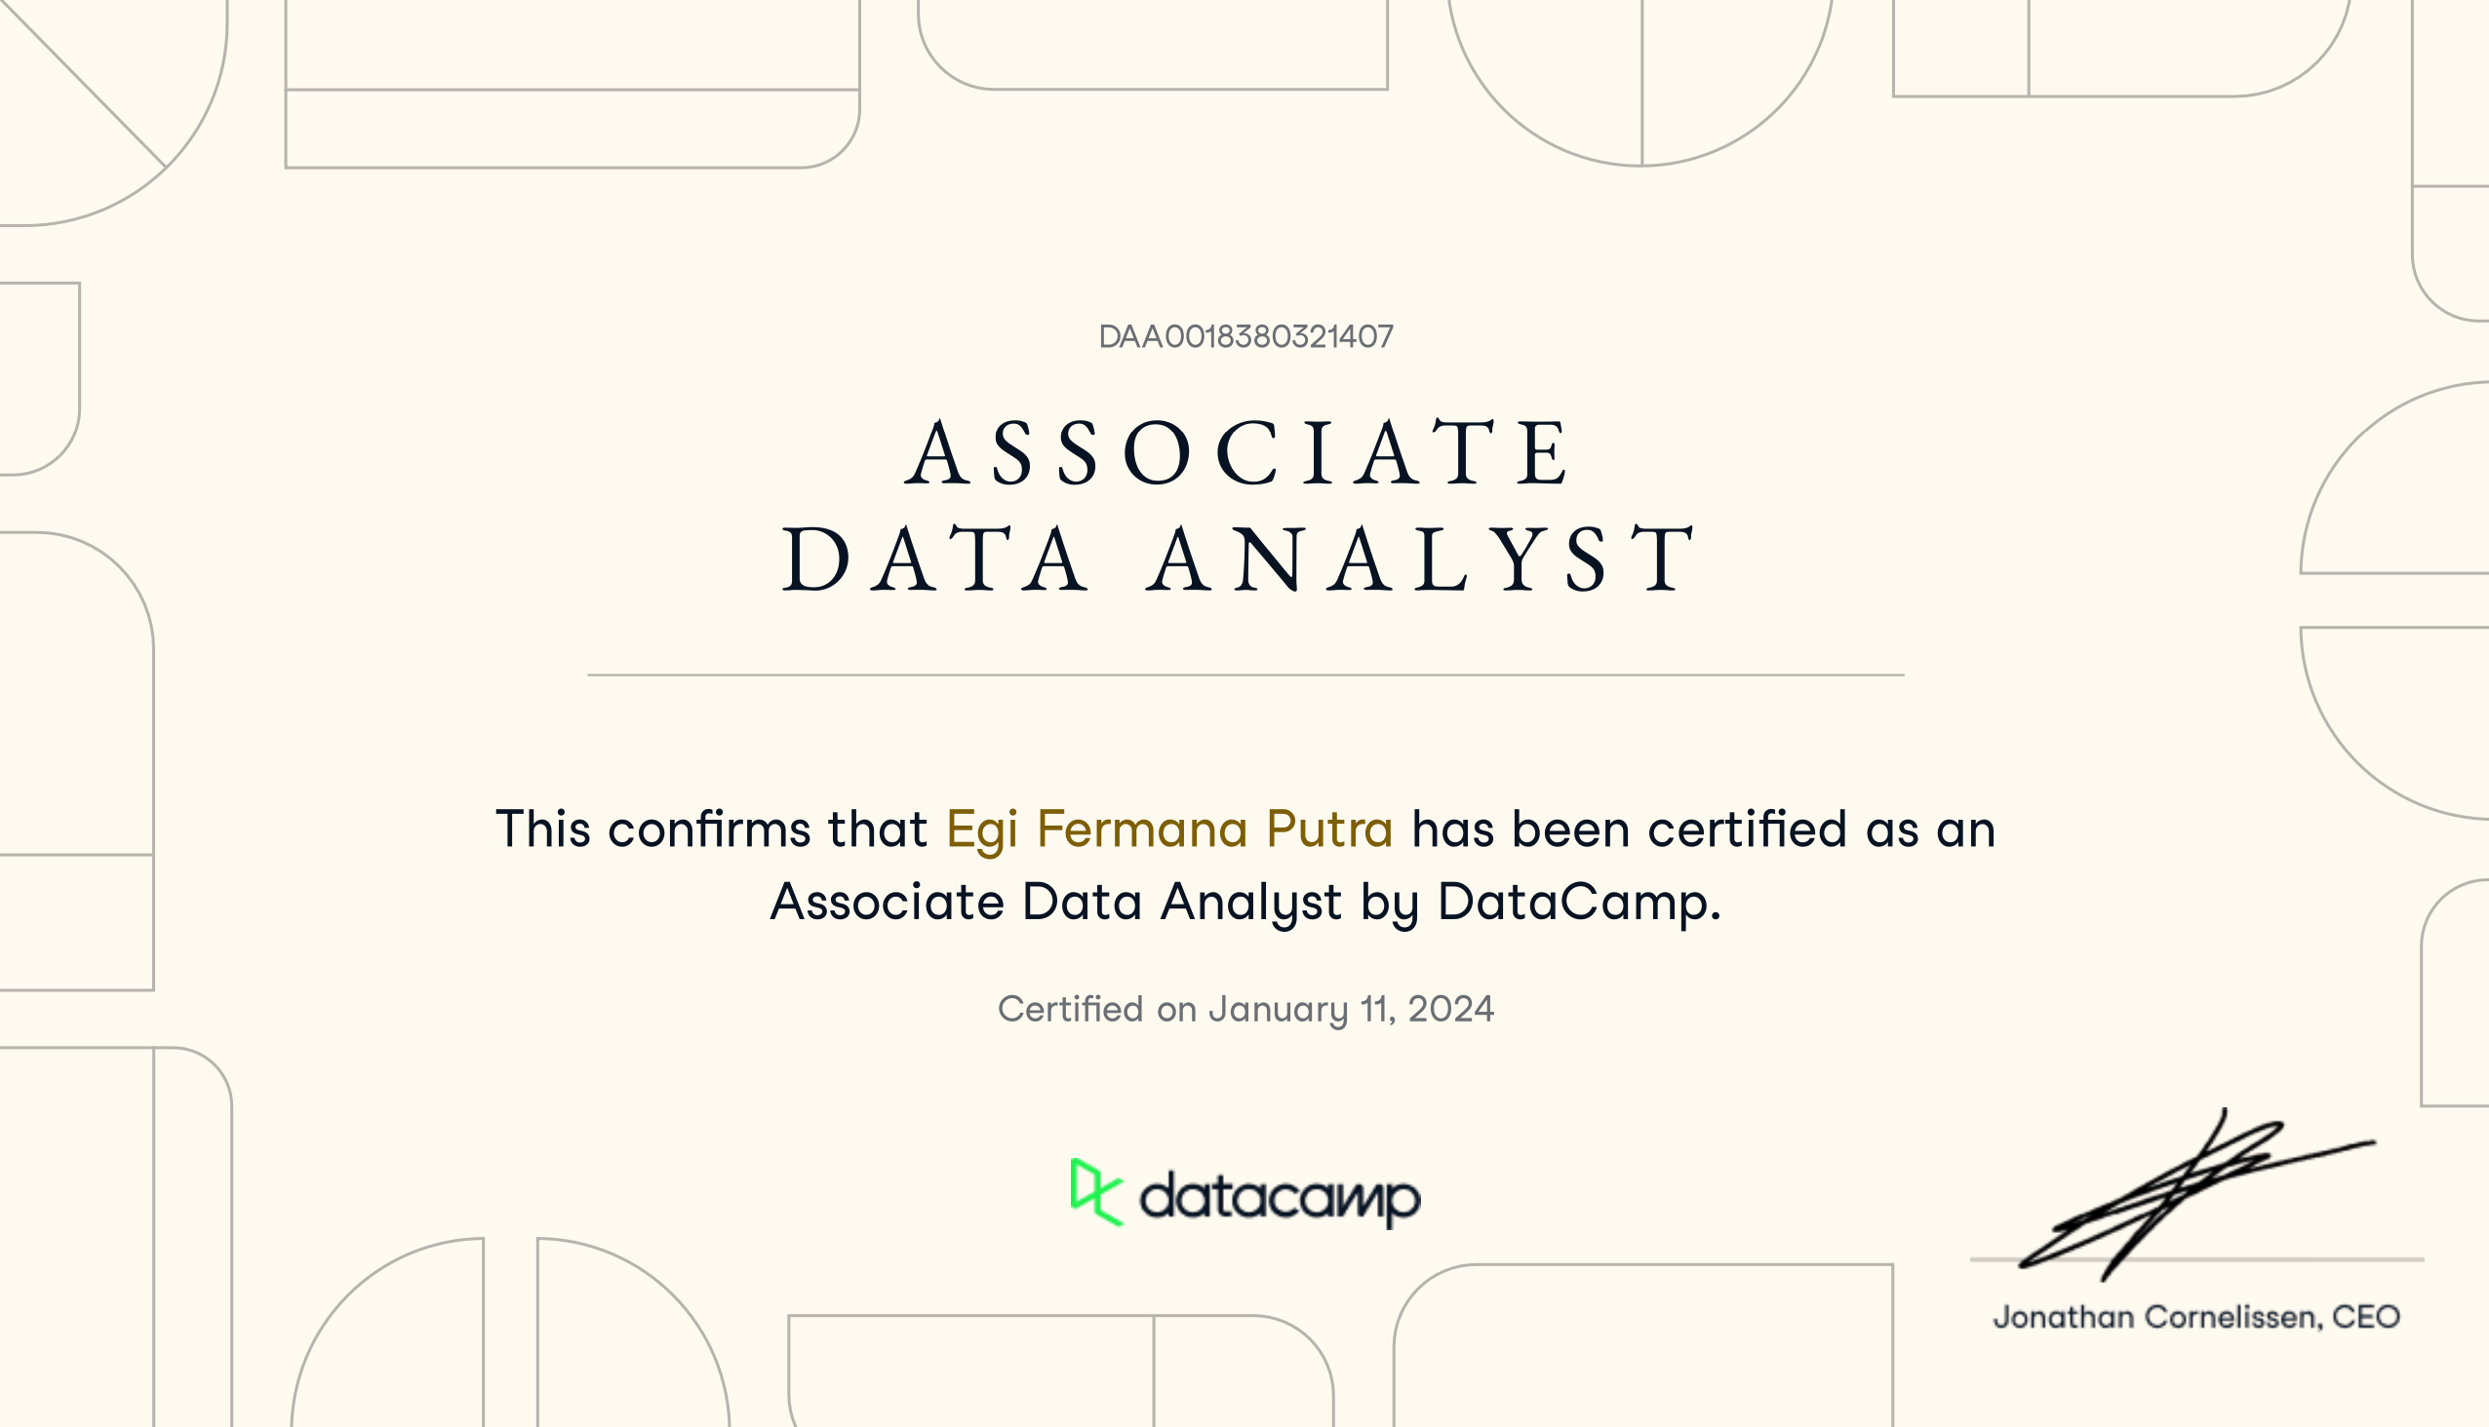
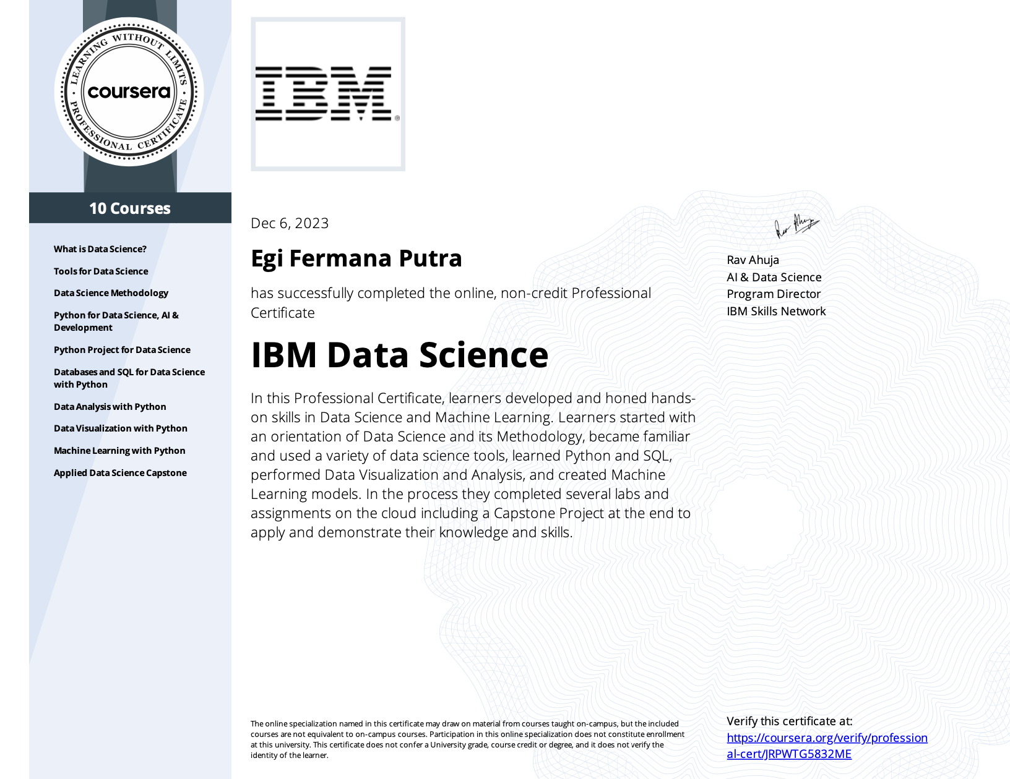

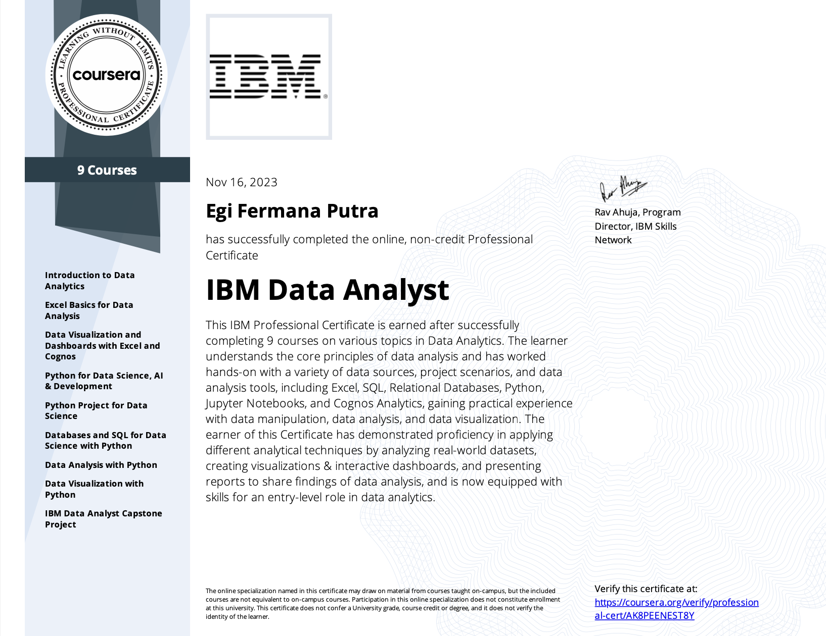
Courses and Certification ✅
Data Analyst Associate | https://www.datacamp.com/certificate/DAA0018380321407 January, 2024
IBM Data Science | https://www.coursera.org/account/accomplishments/specialization/JRPWTG5832ME December, 2023
R Programming A-Z | https://www.udemy.com/certificate/UC-a857c14e-c7f4-4209-93d9-6367a2dc7883 December, 2023
IBM Data Analyst | https://www.coursera.org/account/accomplishments/professional-cert/AK8PEENEST8Y November, 2023
🏅
🏅
🏅
🏅

Slide 4
About Company 💊
Kimia Farma is the first pharmaceutical industry company in Indonesia, founded by the Dutch East Indies government in 1817. The company's original name was NV Chemicalien Handle Rathkamp & Co. Based on the policy of nationalization of former Dutch companies in the early independence period, in 1958, the Republic of Indonesia government merged several pharmaceutical companies into PNF (State Pharmaceutical Company) Bhinneka Kimia Farma. Then on August 16, 1971, the legal form of PNF was changed to a Limited Liability Company, so the company's name was changed to PT Kimia Farma (Persero).

Slide 5

Project Portfolio 😎
This project aims to provide in-depth insights into Kimia Farma sales performance through detailed data analysis. The first step involved importing the dataset into the BigQuery platform to ensure the availability of the necessary data. Subsequently, comprehensive data analysis was conducted using BigQuery to identify relevant trends and patterns in sales. The results of the analysis provide valuable insights into Kimia Farma's sales performance, including factors influencing it.
Through the narrative built from the analysis findings, I can highlight important insights into sales performance, including areas requiring further attention and potential growth opportunities. The prepared infographics and data visualizations provide clear and easily understandable understanding of the analysis findings, facilitating interpretation and decision-making.
GitHub repository here!
Project explanation video here!

Slide 6
The Challenges 🎯
Challenge #1
Challenge #2
Challenge #3
Importing dataset into BigQuery
Creating analytics tables in BigQuery
Creating a performance dashboard in Google Looker
Objective
The objective of the project is to evaluate the business performance of Kimia Farma from 2020 to 2023.

Slide 7

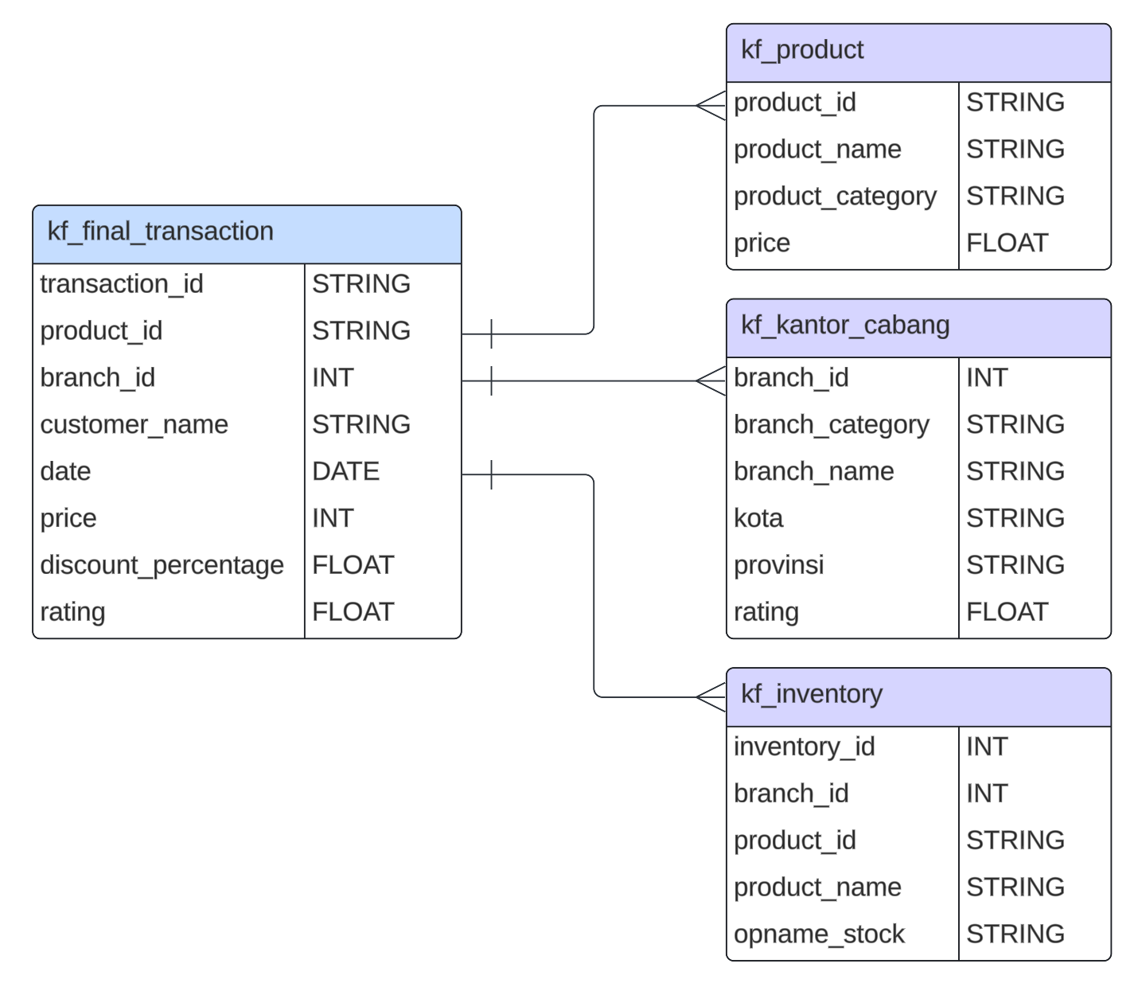



Tools and Datasets ⚙️
Tools
Datasets
Project platform
Execute SQL query
Data visualization
Documentation
Source: Screenshot from Lucid Chart (Link).

Slide 8
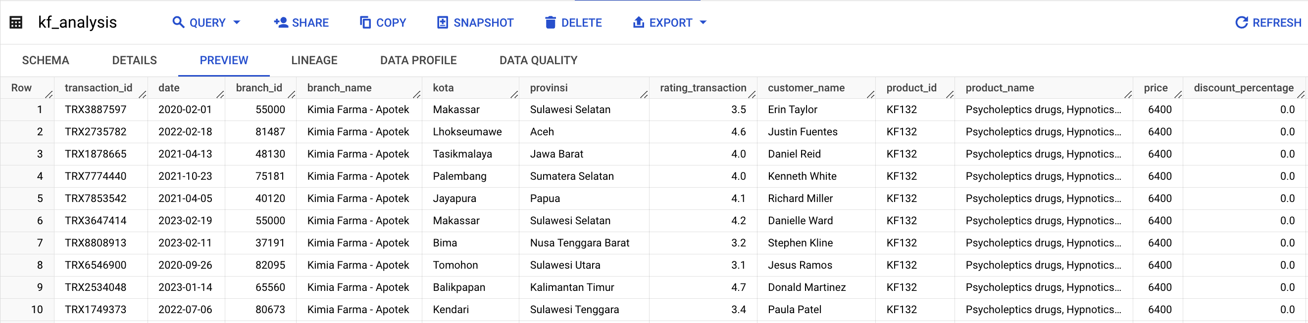
Importing Dataset to BigQuery 🛥️
Prepare the dataset
Create GCP Project:
‘Rakamin KF Analytics’
Open BigQuery Console
Create a Dataset:
‘kimia_farma’
Run SQL query:
Create new table
Data validation
Verify import
Import data into BigQuery
New table preview:

Slide 9
BigQuery Syntax 🔥
This SQL syntax is used to create a new table named kf_analysis in the database kimia_farma. The new table is populated with data selected from existing tables (kf_final_transaction, kf_inventory, kf_kantor_cabang, and kf_product).
Create New Table
This line creates a new table named kf_analysis in the kimia_farma database.
Source: Screenshot from GitHub repository (Link).

Slide 10
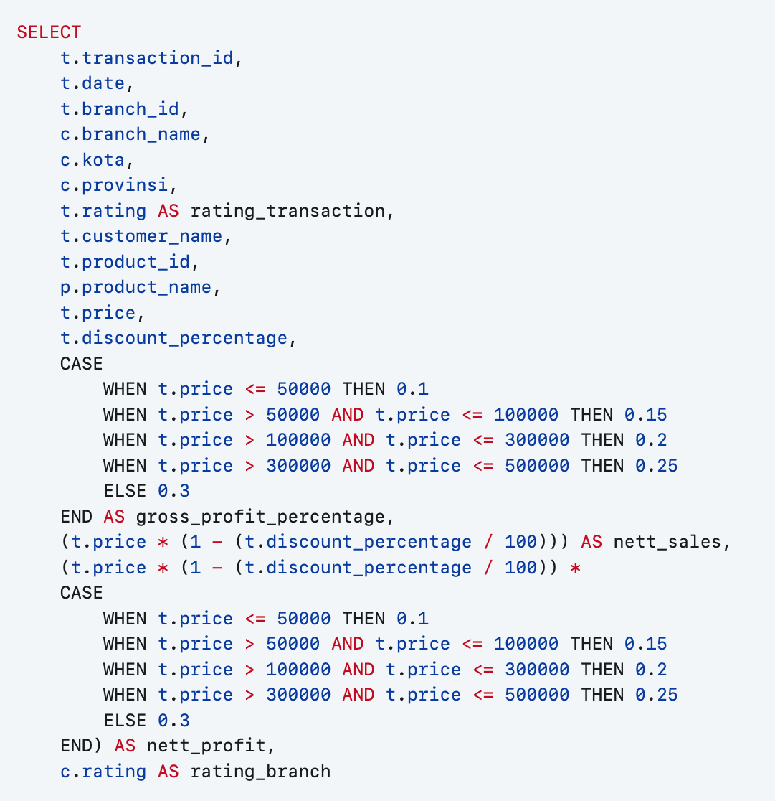
BigQuery Syntax 🔥
Data Selection and Transformation
This SELECT statement fetches data from the specified tables (kf_final_transaction, kf_kantor_cabang, and kf_product). It selects specific columns from these tables and performs transformations on some columns:
It calculates gross_profit_percentage based on the price column.
It calculates nett_sales by subtracting the discount from the price.
It calculates nett_profit based on nett_sales and gross_profit_percentage.
Source: Screenshot from GitHub repository (Link).

Slide 11
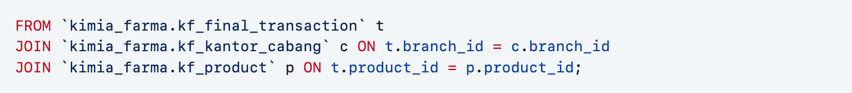
BigQuery Syntax 🔥
Data Joins
This part specifies the tables to be joined (kf_final_transaction, kf_kantor_cabang, and kf_product) and the conditions for joining them. It joins kf_final_transaction with kf_kantor_cabang on branch_id and kf_final_transaction with kf_product on product_id.
Source: Screenshot from GitHub repository (Link).

Slide 12
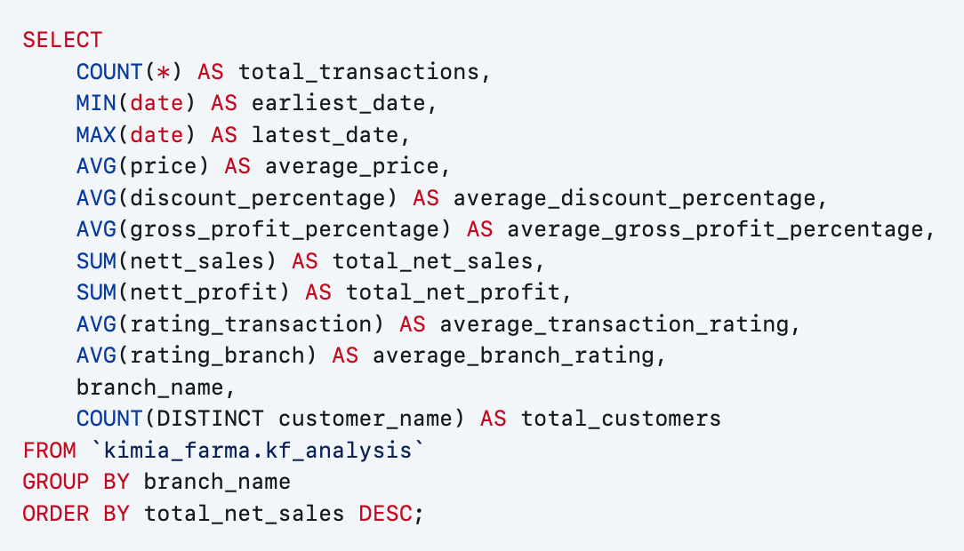
Data Analysis 📊
This SQL syntax enables the analysis of transactional data to gain insights into the performance of different branches of Kimia Farma, facilitating comparisons, trend identification, and informed decision-making.
SQL Query
This query provides the following insights:
Total number of transactions.
Earliest and latest transaction dates.
Average price, discount percentage, and gross profit percentage.
Total net sales and net profit.
Average transaction and branch ratings.
Total number of customers per branch.
Source: Screenshot from GitHub repository (Link).

Slide 13
Performance Insights 💡
Total Transactions | The total number of transactions for each branch ranges from approximately 222,000 to 227,000. This indicates a high volume of activity across all branches.
Transaction Period | The transaction data spans from January 1, 2020, to December 30, 2023, for all branches, showing consistent data collection over a four-year period.
Average Price | The average price of products sold at each branch is relatively consistent, with values around 516,000 to 517,000 units of Indonesian Rupiah. This suggests a uniform pricing strategy across branches.
Average Discount Percentage | The average discount percentage applied to transactions is approximately 7.5% across all branches. This insight can be used to assess the effectiveness of discounting strategies and their impact on sales.

Slide 14
Performance Insights 💡
Profitability | All branches maintain a healthy average gross profit margin around 25.6%. This suggests they are effective at managing their costs. The total net profit figures are also quite similar, again reflecting consistent profitability across the branches.
Customer Satisfaction | There's a very slight difference in average transaction rating around 4.00 and average branch rating around 4.45 across the branches. Overall, customer satisfaction seems positive for all three.
Total Customers | The total number of unique customers served by each branch ranges from approximately 129,000 to 131,000. This insight provides an indication of customer reach and market penetration for each branch.

Slide 15
Infographic Chart 📉
Discover 1: Profit, Transaction, and Customer Performance
Total Profit
Rp98,539,911,168
Total Transaction
672,458
Total Customer
264,601
Total Profit: Kimia Farma had a profitable period between 2020-2023, generating a total profit of nearly Rp100 billion.
Total Transaction: There were over 670,000 transactions during the 2020-2023.
Total Customer: There were also over 260,00 customers who made purchases.

Slide 16
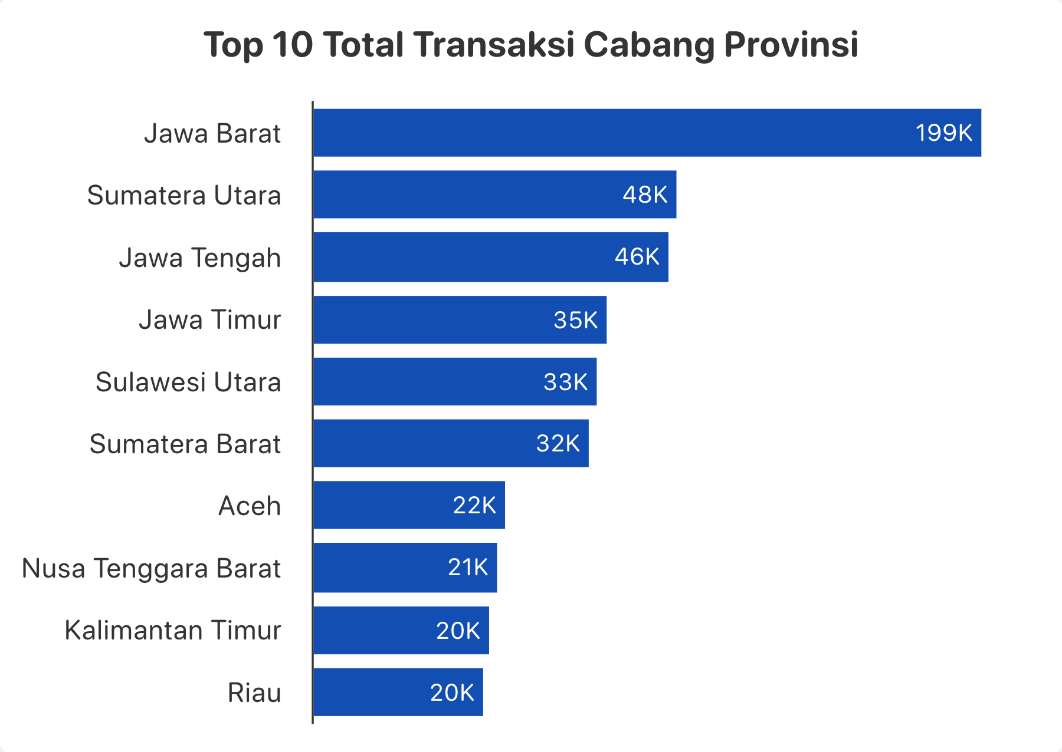
Infographic Chart 📉
Discover 2: Top 10 Total Transactions by Province Branch
Jawa Barat is the province with the most Kimia Farma drug transactions. There were 199,000 transactions in Jawa Barat.
Sumatera Utara is the province with the second most Kimia Farma drug transactions. There were 48,000 transactions in Sumatera Utara.
Jawa Tengah ranks third in total transactions. There were 46,000 transactions in Jawa Tengah.
The remaining provinces on the list have considerably fewer transactions. Sulawesi Utara has 33,000 transactions, Sumatera Barat has 32,000 transactions, Aceh has 22,000 transactions, Nusa Tenggara Barat has 21,000 transactions, Kalimantan Timur has 20,000 transactions, and Riau has 20,000 transactions.
Source: Screenshot from Looker Studio (Link).

Slide 17
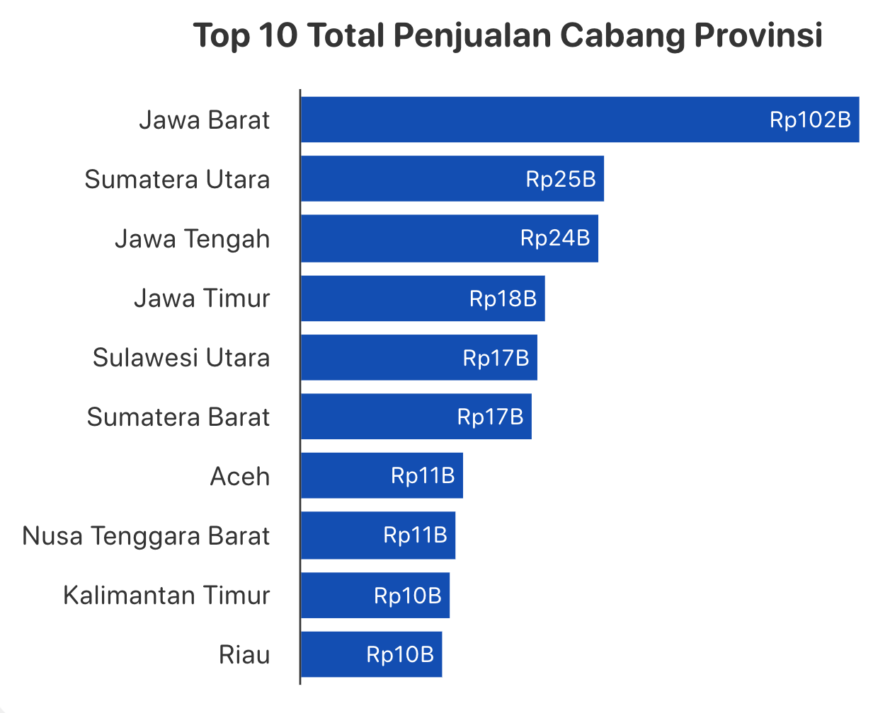
Infographic Chart 📉
Discover 3: Top 10 Total Sales by Province Branch
Jawa Barat leads the way in total sales among all provinces. The total sales for Jawa Barat is Rp102 billion.
Sumatera Utara ranks second in total sales. Sumatera Utara has a total sales of Rp25 billion.
Jawa Tengah comes in third place with a total sales of Rp24 billion.
The remaining provinces have significantly lower total sales compared to the top 3. Here's the breakdown for the remaining provinces: Jawa Timur Rp18 billion, Sulawesi Utara Rp17 billion, Sumatera Barat Rp17 billion, Aceh Rp11 billion, Nusa Tenggara Barat Rp11 billion, Kalimantan Timur Rp10 billion, and Riau Rp10 billion.
Source: Screenshot from Looker Studio (Link).

Slide 18
Summary and Feedback 📋
Summary Insight
Actionable Recommendation
Uniform Pricing Strategy and Discounting Effectiveness: The similarity in average product prices and discount percentages across branches suggests a standardized pricing and discounting strategy.
Regional Sales Disparities: The significant difference in total sales between the top three provinces and the rest highlights the importance of regional sales analysis and targeted strategies.
Positive Customer Satisfaction: The high average transaction and branch ratings indicate overall positive customer satisfaction.
Effective Cost Management and Profitability: The healthy average gross profit margin and consistent net profit figures indicate effective cost management practices across all branches.
To further optimize sales, consider conducting A/B testing on different discount levels or personalized discount offers to identify the most effective strategies for driving sales without compromising profitability.
Allocate resources and marketing efforts based on regional sales performance to maximize revenue generation across all provinces.
Conducting customer surveys or implementing feedback mechanisms can help identify specific areas for enhancement.
Continue to monitor and optimize operational efficiency to maintain or improve profitability over time.

Slide 19
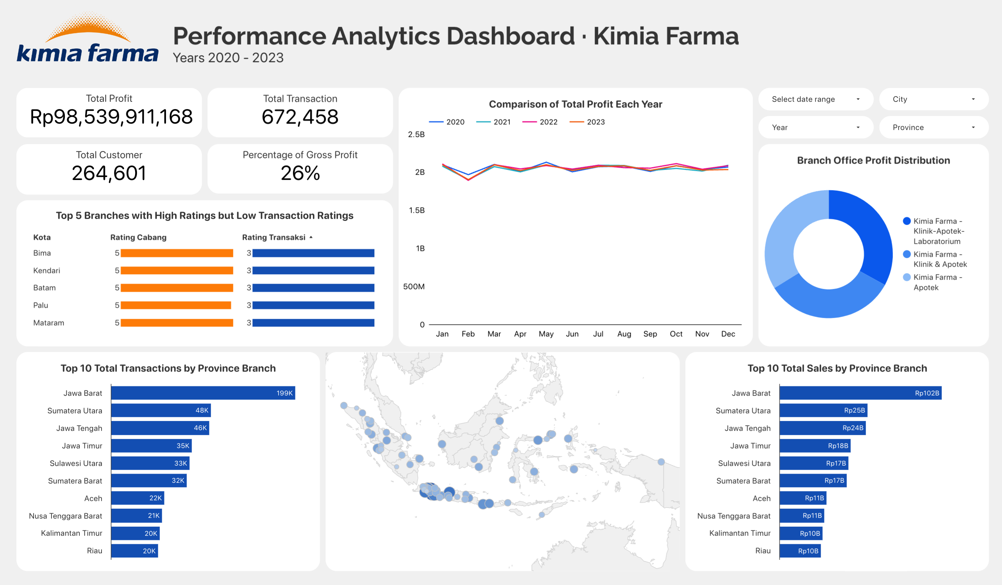
Dashboard Performance Analytics 📊
Link: https://lookerstudio.google.com/reporting/18f1346f-49e6-41f9-b46c-c47cf0e4fdf9

Slide 20
Thank You
×

